Slide 1
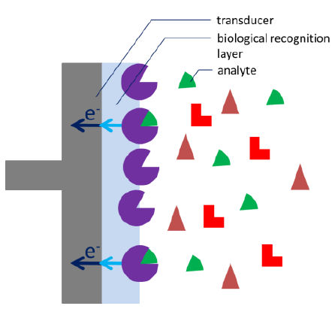
Lab 4: Detection of Glucose with a Self-Made Biosensor Based on Glucose Oxidase
A biosensor uses a biological recognition element to convert a chemical signal into an electrical one.

Slide 2
Glucose sensors
Based on the catalytic effect of glucose oxidase (GOD) enzyme
H2O2 based glucose sensor
at the anode
Notes:
The hydrogen peroxide diffuses towards the electrode and is oxidized at the electrode. After the GOx has oxidized the glucose to gloconolactone, the GOx transfers the electrons from the Glucose to oxygen reducing it to hydrogen peroxide. Gluconolactone is hydrolysed in aqueous solutions to gluconic acid. There are even glucose sensors that exploit the induced pH change.
Hydrogen peroxide is a by-product of the oxidative process.
hydrogen peroxide detection is useful for fuel cell catalyst research, for controlling the amount of disinfectants used, for waste water control and as basis for a biosensor with a hydrogen peroxide producing enzyme.
Hydrogen peroxide has two disadvantages: Its high oxidative power makes it unstable and corrosive. Because of these characteristics it qualifies as a propellant, but it also can lead to an explosion of high concentrated hydrogen peroxide. And hydrogen peroxide can also damage the skin. Its corrosive influence can be easily identified by white spots on your skin accompanied by a burning or stinging feeling. Washing the skin with a lot of water is advised. After a short period of time the pain should disappear, but the white spots may remain for a few days. The instability is an issue as well, despite the fact that many hydrogen peroxide solutions have additives to stabilize the peroxide, hydrogen peroxide solutions should be stored cold and dark, otherwise the peroxide might decompose fast. This has the advantage that hydrogen peroxide can easily be removed from any solution by boiling it for several minutes.

Slide 3
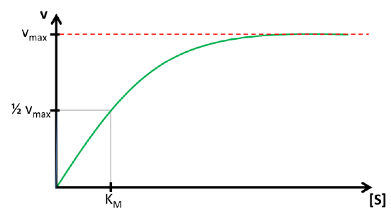
Theoretical bases
velocity v vs. substrate [S] for fixed amount of enzyme.
The curve is saturated when all E is converted to ES.
vmax determines the sensitivity (current per concentration)
[S]max determines range of concentration
KM: Michaelis-Menten-constant
concentration of [S] for 0.5vmax
if v=0.5vmax,
half of the total enzyme’s amount is present as ES
KM determines the linear range
Notes:
If we have a fixed amount of enzyme solution and observe the velocity while increasing the substrate concentration, a saturation curve is observed (see Figure 4.52). This happens because with increasing substrate concentration more E is converted to ES. At some point all E is converted to ES and further addition of the substrate will not produce more ES. A well working analogy is a supermarket with all checkouts open. If there are 5 checkouts and 2 customers, 2 customers can pay in 30 s. If the number of customers is increased to 5, 5 customers can pay in 30 s, that is the velocity vR (customers checked out per time) is increased. More customers, for example 10, will not increase the vR, but queues will be formed at the checkouts.
The maximum velocity vmax and the lowest concentration with vmax ([S]max) are two parameters that contain important information. The reaction rate or velocity v determines how often S is converted to P and thus how often electrons are transferred to the enzyme. Because these electrons will directly or indirectly be donated or accepted by the electrode, the reaction rate during the measurement is represented by the measured current. This means the higher vmax the higher the current per concentration, also known as sensitivity. [S]max determines the range of concentration where the current depends on [S]. If [S]max is very high, a large range of concentrations can be detected with this enzyme.
It is difficult to determin Vmax and [S]max, because one don’t know when the curve can be called as saturated. So 1/2vmax is used.
Knowledge of the Michaelis-Menten constant KM has another advantage. In Figure 4.52 it is visible that the saturation curve at the beginning is close to a linear relationship. Usually quantitative measurements need to be in this linear segment of the curve. The curve can be treated as linear up to a concentration of KM. If the Michaelis-Menten constant is known, also the linear range of the biosensor is known. Typical values for KM are between 10-2 - 10-6 mol/l.

Slide 4
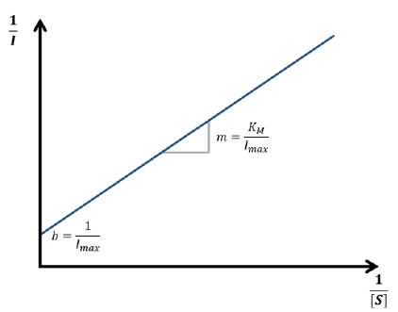
Theoretical bases
Determine KM and Vmax using Lineweaver-Burk equation
$$\frac{1}{v_{R}}=\frac{1}{v_{max}}+\frac{K_{M}}{v_{max}[S]}$$
Lineweaver-Burk plot
Notes:
According to the Lineweaver-Burk equation a plot of 1/vR versus 1/[S] should deliver a line with the intersection 1/vmax and slope KM/vmax. Such a plot is called a Lineweaver-Burk plot, but in an amperometric experiment 1/I is plotted versus 1/[S]
The lineweaver-burk equation can be used to determine KM and Vmax,
The equation relates vR with [S], VR is a parameter that can be measured, for example, it can be indicated by the current in an electrochemical cell sensor during an amperometric measurement. The concentration of S is a known value.
During an amperometric measurement we can control the concentration of substrate [S] and we measure the vR as the current I. The unknown values of equation 4.34 are the two values we want to evaluate: vmax and KM.
KM: linear range
Vmax: sensitivity.

Slide 5
Some final notes:
Don’t forget to save the measured raw data. Plot out. Analyse.
Please tidy up after you finish your experiments
Turn off all the equipment
Leave equipment/materials at their original place.

