Slide 1
The Leavers
A Few Key Ideas Around Work

Slide 2
Labor and Class
Asian American immigrants frequently take on work in the service industry -- food, cleaning, and beauty work like nail salons.
Why do you think this is true?
What are the problems of associating immigrant labor--especially immigrant women’s labor--with menial, low-paying positions?

Slide 3
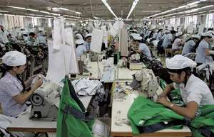
Labor and the Third World
Although many countries in Asia, like China, are now considered more “developed” than “developing.” But they are still often the sites of industrialism and factory labor.
Work in these factories promotes movement from impoverished rural areas to more prosperous urban centers, but conditions in these factories--which support big corporations like Apple, Nike, etc.--are still very poor and the wages are very low.
Surprisingly, there are also still factories like this in the United States, in ethnic enclaves like Chinatown.
What are some examples of menial, factory-based work mentioned in The Leavers?

Slide 4
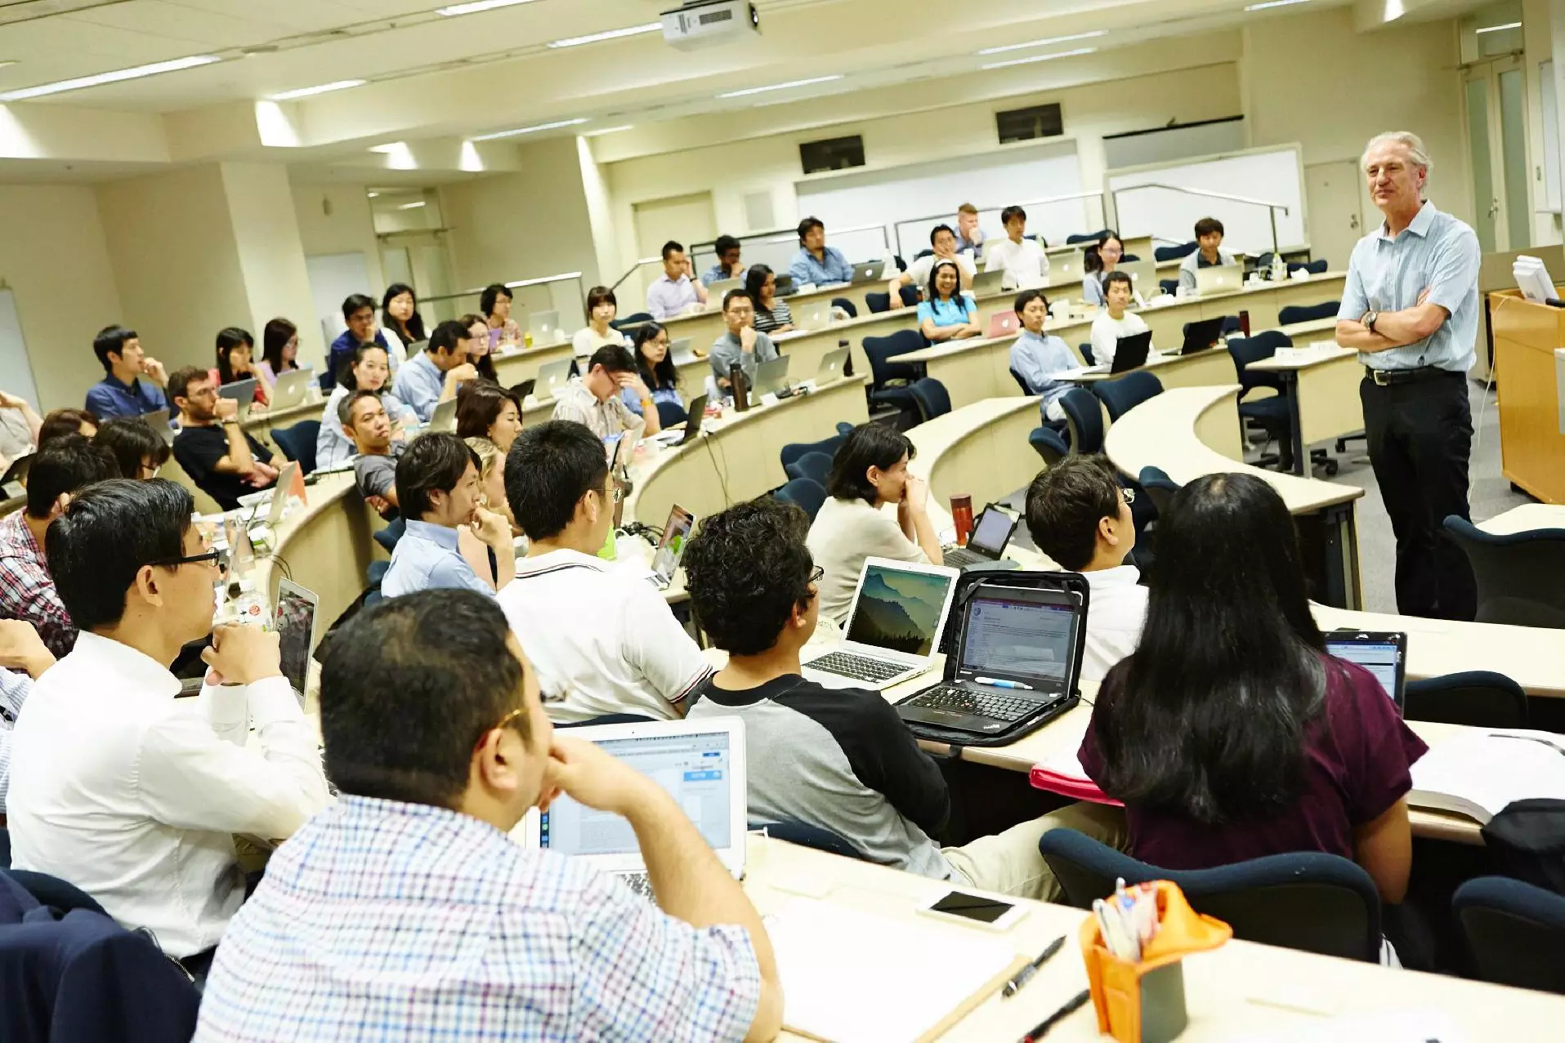
Labor and the Global Economy
In an increasingly global, transnational world, there is an increased need for work that supports companies as they spread worldwide.
This has led to an increase in the number of service jobs in the third world such as call centers and English language schools.
Are these kinds of service jobs different from the menial ones mentioned before? Or are they similar or connected in any way?

Slide 5
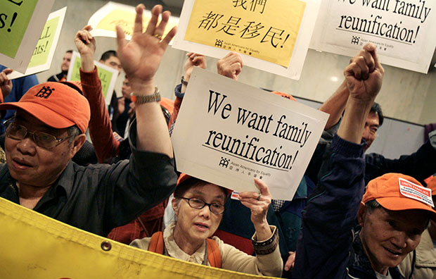
Labor and Immigration
It is commonly accepted that most immigrants migrate in pursuit of a “better life.” What are some of the aspects of a “better life” that they might be searching for?
The promise of a better life can lead to desperate and illegal measures, wherein immigrants enter the country secretly or without proper documentation. Although, more often than not, undocumented immigrants enter the country completely legally (through work or student visas) and then become undocumented when their visas expire.
Is the “promise” of immigration a false promise? What are sacrifices and difficulties that immigrants face that might make that promise seem impossible to achieve?

Slide 6
Online Scavenger Hunt!
In small groups, choose one of the following key ideas or topics related to our book and our discussion. Find 2-3 sources (websites, online news articles, videos, etc.) that provide further context about this theme. You will post a link to your sources in the Google doc posted on Canvas. This will serve as a collaborative class bibliography for future assignments and discussions!
Topics: Asian Americans & Nail Salons; Sweatshop Labor; Asian Call Centers; Asian English Schools; The Chinatown Garment Industry; Asian Americans & Undocumented Immigration; Immigrant Rights and Advocacy

Slide 7
Books Questions for Consideration
Polly's story is told in the first person while Deming's is in the third person. Why do you think the author made that choice?
What role do Deming’s music and his gambling play; how do they help assuage his pain? At one point, after a performance with his band, Deming slips out, thinking to himself, "It felt good being the one making the excuse to get away." What does he mean?
Polly is the one who sees the nature of the immigration system firsthand. How is the system portrayed in the novel? What do you think the novel is saying about immigration and identity in America?

Slide 8
Character Analysis
In small groups, choose ONE of the following characters. You will analyze the characters using the following guidelines:
Using evidence from the novel, come up with three adjectives to describe them.
Decide whether they are a sympathetic character or not. (In other words, are their choices and actions ones that we can understand or sympathize with? Or do you think they have only negative or selfish intent?)
Describe how they draw our attention to one of the major themes of the novel: Change. (Again, use evidence as much as possible.)
Characters: Deming, Polly, Kay

