Slide 1
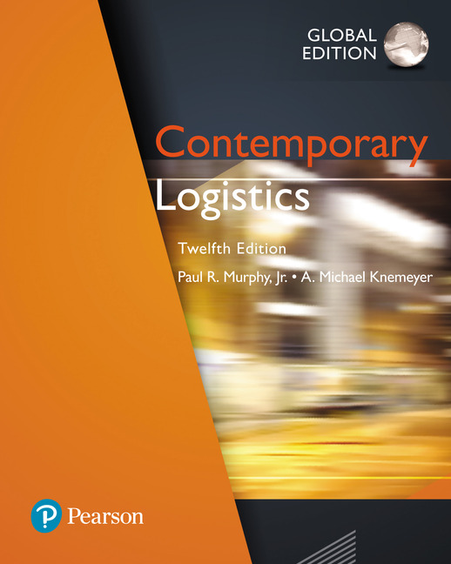
Contemporary Logistics
Twelfth Edition, Global Edition
Chapter 4
Organizational and Managerial Issues in Logistics
Copyright © 2018 Pearson Education, Ltd. All Rights Reserved.

Slide 2
Learning Objectives (1 of 2)
4.1 To explain organizational structure for logistics
4.2 To compare traditional and contemporary organizational design for logistics
4.3 To identify productivity issues and improvement efforts in logistics
4.4 To discuss quality issues in logistics
Notes:
Slide 2 is list of textbook LO numbers and statements

Slide 3
Learning Objectives (2 of 2)
4.5 To describe ways to manage theft and pilferage
4.6 To review the concept of logistics social responsibility
4.7 To articulate issues associated with reverse logistics
4.8 To report on programs designed to lessen the impact of terrorism on logistics systems
Notes:
Slide 3 is list of textbook LO numbers and statements

Slide 4
Organizing Logistics Within the Firm (1 of 8)
Two key organizational logistics topics
Organizational structure
Organizational design

Slide 5
Organizing Logistics Within the Firm (2 of 8)
Organizational structure for logistics
Two basic structures include:
Fragmented logistics structure
Logistics activities are managed in multiple departments throughout an organization
Unified logistics structure
Multiple logistics activities are combined into and managed as a single department

Slide 6
Organizing Logistics Within the Firm (3 of 8)
Organizational structure for logistics
Two basic structures for logistics departments include:
Centralized logistics organization
Company maintains a single logistics department that administers the related activities for the entire company from the home office
Decentralized logistics organization
Logistics-related decisions are made separately at the divisional or product group level and often in different geographic regions

Slide 7
Organizing Logistics Within the Firm (4 of 8)
Organizational structure for logistics
Job title or corporate rank
Leading-edge organizations tend to head the logistics department by senior-level personnel
Generally excluded from holding a “C-level” position

Slide 8
Organizing Logistics Within the Firm (5 of 8)
Organizational design for logistics
Three primary types of organizational design include:
Hierarchical (functional)
Top-down flow
Matrix
Cross-functional responsibilities
Network
Process philosophy focused on combining tasks into value-creating products and activities

Slide 9
Organizing Logistics Within the Firm (6 of 8)
Organizational design for logistics
Network organizational design is manifested in terms of:
Relevancy
Refers to satisfying current and emerging customer needs
Facilitated by developing mutually beneficial relationships with key customers
At a minimum, these relationships should provide an understanding of customer needs and wants

Slide 10
Organizing Logistics Within the Firm (7 of 8)
Organizational design for logistics
Network organizational design is manifested in terms of:
Responsiveness
Reflects the degree to which an organization can accommodate unique or unplanned customer requests
Achieved when the appropriate decision makers are provided with both relevant information and the authority to address unique or unplanned requests

Slide 11
Organizing Logistics Within the Firm (8 of 8)
Organizational design for logistics
Network organizational design is manifested in terms of:
Flexibility
Is an organization’s ability to address unexpected operational situations
Predicated on avoiding early commitment to an irreversible course of action

Slide 12
Managerial Issues in Logistics (1 of 28)
Productivity
Quality
Risk
Sustainability
Complexity

Slide 13
Managerial Issues in Logistics (2 of 28)
Productivity
Can be defined as the amount of output divided by the amount of input
Provides insight into the efficiency with which corporate resources are being utilized

Slide 14
Managerial Issues in Logistics (3 of 28)
Productivity
Three ways to improve productivity include:
Reduce the amount of input while holding output constant
Increase the amount of output while holding input constant
Increase output while decreasing input

Slide 15
Managerial Issues in Logistics (4 of 28)
Productivity
Labor productivity
Warehousing and transportation are heavily dependent on human labor
Human labor is an input (i.e., workers receive wages or salaries)
Productivity improvement efforts in logistics are often directed toward increasing the amount of output while holding input constant (workers resistant to suggestions regarding reduced wages or salaries)

Slide 16
Managerial Issues in Logistics (5 of 28)
Productivity
Asset productivity
Concerns include:
Space utilization
Excess capacity (unused available space)
Can be unproductive as it may result in the purchase of additional equipment or facilities, which adds costs (input)
May not yield additional output resulting in a productivity decline

Slide 17
Managerial Issues in Logistics (6 of 28)
Productivity
Asset productivity
Concerns include:
Improving the output from existing assets
Increases productivity as inputs remain constant, but output is increased

Slide 18
Managerial Issues in Logistics (7 of 28)
Quality
Logistics service quality
Relates to a firm’s ability to deliver products, material, and services without defects or errors to both internal and external customers¹
¹E.A. Morash, C. Droge, and S. Vickery, “Strategic Logistics Capabilities for Competitive Advantage and Firm Success,” Journal of Business Logistics 17, no. 1 (1996): 1–22.

Slide 19
Managerial Issues in Logistics (8 of 28)
Quality
Quality in logistics involves trade-offs
If inferior logistic service quality, customers may perceive lower value
If superior logistic service quality than expected or required, organization may be adding unnecessary cost
Organizations must try to match the quality levels of the logistic services they provide with the expectations of their customers and the landscape in which they operate

Slide 20
Managerial Issues in Logistics (9 of 28)
Quality
Vendors are expected to have quality programs
Vendors can demonstrate commitment to quality to potential buyers through achieving and maintaining quality program certification
ISO (International Standards Organization) 9000 certification is an example of a quality program certification

Slide 21
Managerial Issues in Logistics (10 of 28)
Quality
ISO 9000
Is a set of generic standards used to document, implement, and demonstrate quality management and assurance systems
Is applicable to both manufacturing and service firms
Standards are intended to help companies build quality into every core process in each department

Slide 22
Managerial Issues in Logistics (11 of 28)
Quality
ISO 9000
Firms demonstrating commitment to quality through training, reviews, and continuous improvement achieve initial ISO 9000 certification
Once certification is obtained, audits are conducted annually and organizations can be recertified every three years
Certification is credited with
an increase in customer service
improved order accuracy
enabling enhanced costs analysis

Slide 23
Managerial Issues in Logistics (12 of 28)
Quality
Six Sigma
Is a quality-focused methodology that emphasizes the virtual elimination of business errors
Area covered under a normal curve is by six standard deviations is 99.99966 percent
Approach suggests that there will be 3.4 defects, deficiencies, or errors per one million opportunities
Can be applied to various logistics activities such as order packing

Slide 24
Managerial Issues in Logistics (13 of 28)
Quality
Six Sigma
Benefits
Reduced costs
Reduced errors and waste
Reduced cycle time
Drawbacks
Overcoming business cultural barriers
Investing required resources (both human and money)
Gaining top management commitment

Slide 25
Managerial Issues in Logistics (14 of 28)
Quality
Lean Six Sigma
Is a quality-focused methodology that integrates Six Sigma with the Lean approach
Integrates the goals and methods of these two approaches in pursuit of quality
Unique because it recognizes that organizations cannot focus only on quality or speed
Emphasizes an organizational focus on improving quality as it relates to responsiveness

Slide 26
Managerial Issues in Logistics (15 of 28)
Quality
Malcolm Baldrige National Quality Award
Recognizes organizations for their achievements in quality and performance
Established in the late 1980s
Restricted to firms headquartered in the United States
Eligibility initially limited to:
Manufactures, services, and small businesses
Eligibility expanded to include:
Health care and educational institutions

Slide 27
Managerial Issues in Logistics (16 of 28)
Risk
Can be viewed as susceptibility to disruptions that could lead to a loss for a firm
Can take a variety of forms as it relates to logistics management activities
Regularly occurring (or operational) risks (e.g., variability in demand or potential for a damaged shipment)
Catastrophic risks (e.g., earthquakes or terrorist attacks)

Slide 28
Managerial Issues in Logistics (17 of 28)
Risk
Logistics uncertainty pyramid model
Established to identify sources of uncertainty that can affect the risk exposure for logistics activities
Identifies several types of uncertainty including shipper, customer, carrier, control systems, and external

Slide 29
Managerial Issues in Logistics (18 of 28)
Risk
Terrorism is an example of catastrophic risk
Terrorism can be defined as “an illegal use of or threat of force or violence made by a group or individual against a person, a company, or someone’s property with a goal of menacing the target, often grounded in politics or ideology.”²
²Terrorism, The American Heritage® Dictionary of the English Language, 4th ed. (n.d.). Retrieved from Dictionary.com website: http://dictionary.reference.com/browse/terrorism.

Slide 30
Managerial Issues in Logistics (19 of 28)
Risk
Creation of the Department of Homeland Security (DHS)
Federal agency
Goals
To prevent terrorist attacks in the U.S.
To reduce the vulnerability of the U.S. to terrorism

Slide 31
Managerial Issues in Logistics (20 of 28)
Risk
The 22 separate government entities incorporated into DHS include:
Transportation Security Administration (TSA)
Transportation Worker Identification Credential (TWIC)
Customs and Border Protection (CBP)
Container Security Initiative (CSI)
Customs Trade Partnership Against Terrorism (C-TPAT)
Importer Security Filing (ISF) rule, also known as “10+2”

Slide 32
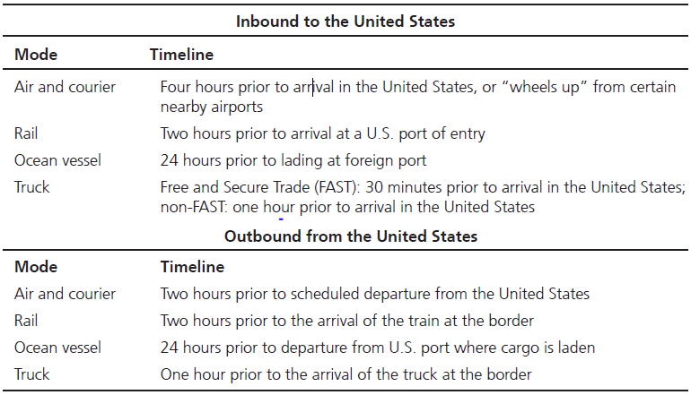
Table 4.1: Timeline for Presenting Electronic Advance Manifest Information
Source: Erlinda Byrd, “Rules for Improving Cargo Security,” Customs and Border Protection Today, March 2004.

Slide 33
Managerial Issues in Logistics (21 of 28)
Risk
Theft is another logistics risk issue that confronts many managers
Theft (stealing) can be defined as the taking and removing of personal property with the intent to deprive the rightful owner of it.³
³www.m-w.com/dictionary

Slide 34
Managerial Issues in Logistics (22 of 28)
Risk
Thoughts regarding theft
Insurance companies may reimburse for loss, but time and costs tend not to be covered
Theft results in the planned flow of goods being interrupted, which can lead to stockouts
Theft can factor into facility location decisions

Slide 35
Managerial Issues in Logistics (23 of 28)
Risk
Thoughts regarding pilferage (employee theft)
Transportation and warehousing operations are particularly vulnerable to pilferage
Managing pilferage begins with the hiring process
Zero-tolerance pilferage policy
Keep goods moving through the system
Recent increase in pirate attacks

Slide 36
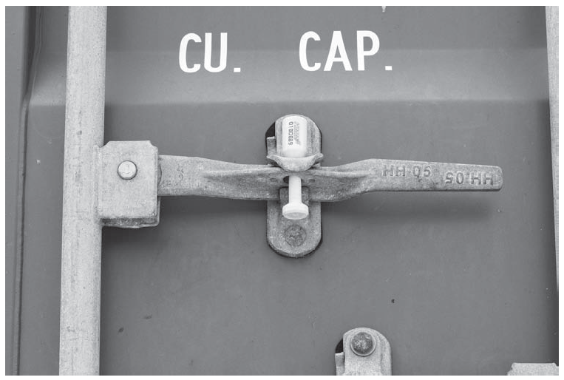
Figure 4.1: Shipping Container Locking Handle with a Uniquely Numbered Customs Seal
Source: Philip Cridland/Alamy Stock Photo

Slide 37
Managerial Issues in Logistics (24 of 28)
Sustainability
Logistics social responsibility
Corporate social responsibility issues that relate directly to logistics

Slide 38
Managerial Issues in Logistics (25 of 28)
Sustainability
Logistics social responsibility
Potential dimensions include:
Environment
Ethics
Diversity
Safety
Philanthropy
Human rights
Others

Slide 39
Managerial Issues in Logistics (26 of 28)
Sustainability
Reverse logistics
Is the process of managing return goods
Exceeds $100 billion in U.S. alone
Can be four to five times more expensive than forward logistics
Process can take 12 times as many steps as forward logistics

Slide 40
Managerial Issues in Logistics (27 of 28)
Sustainability
Reverse logistics
Reverse logistics process focuses on:
Why products are returned
How to optimize reverse logistics
Whether reverse logistics should be managed internally or outsourced to a third party⁴
⁴John Paul Quinn, “Are There Ever Any Happy Returns?” Logistics Management, June 2005, 63–66.

Slide 41
Managerial Issues in Logistics (28 of 28)
Complexity
Network complexity
Is the growing number of nodes and the associated changes to the links in logistics systems
Process complexity
Centers on the haphazard development of processes, additions and modifications to processes over time, and/or changing process requirements
Range complexity
Centers on the implications associated with the increasing number of products that most companies continue to face in an effort to differentiate themselves with their customers

Slide 42
Key Terms (1 of 3)
“C-level” position
Centralized logistics organization
Container Security Initiative (CSI)
Customs Trade Partnership Against Terrorism (C-TPAT)
Decentralized logistics organization
Excess capacity
Fragmented logistics structure
Importer Security Filing (ISF) rule

Slide 43
Key Terms (2 of 3)
ISO 9000
Lean Six Sigma
Logistics service quality
Logistics social responsibility
Logistics uncertainty pyramid model
Malcolm Baldrige National Quality Award
Pilferage
Productivity
Reverse logistics
Sharing economy

Slide 44
Key Terms (3 of 3)
Six Sigma
Tachograph
Theft
Transportation worker identification credential (TWIC)
Unified logistics structure

