Slide 2
Allard Marx
Marketing graduate
Brand management:
Courtaulds
Colgate Palmolive
Coca-Cola Amatil
International marketing manager LIGplc
Landor Associates – client services director
Incide – managing partner

Slide 3
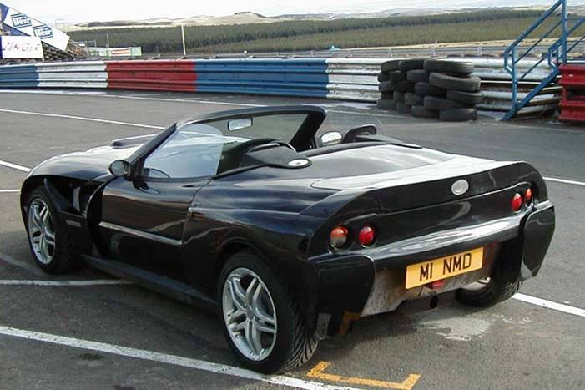
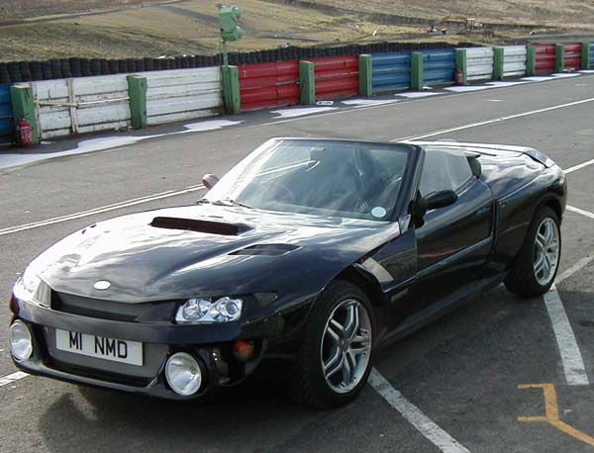
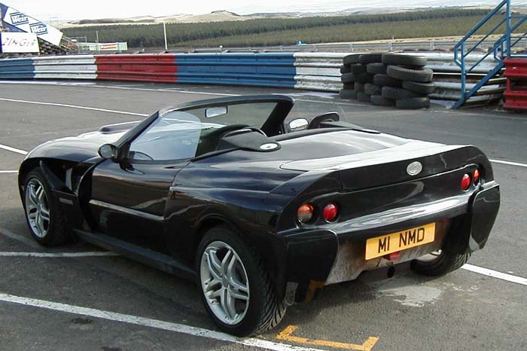

Slide 4
Turbo-charged flat 4
Power: 205.8 kw / 276 bhp @ 5650 rpm
Torque: 347.09 nm / 256 ft lbs @ 4000 rpm
Body/frame: utra lightweight composite fibre
AWD
0-60mph 3.8 seconds

Slide 5
The DELFINO Feroce
Can you think of a name for this car?

Slide 6
The “DELFINO Feroce”
The “Ferocious Dolphin”

Slide 7
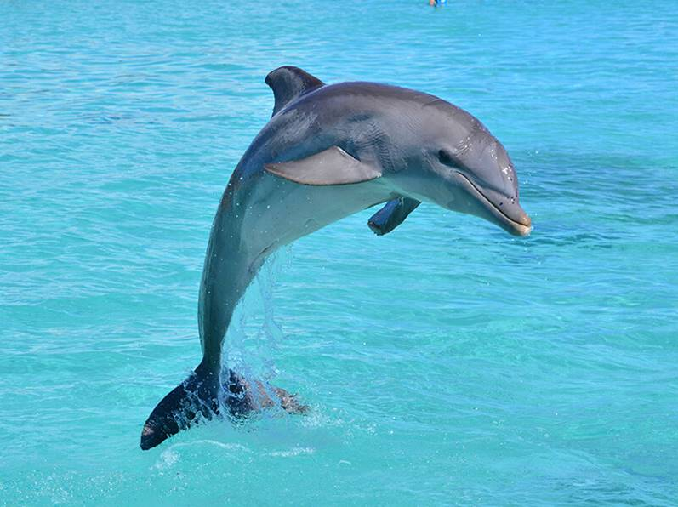

Slide 8
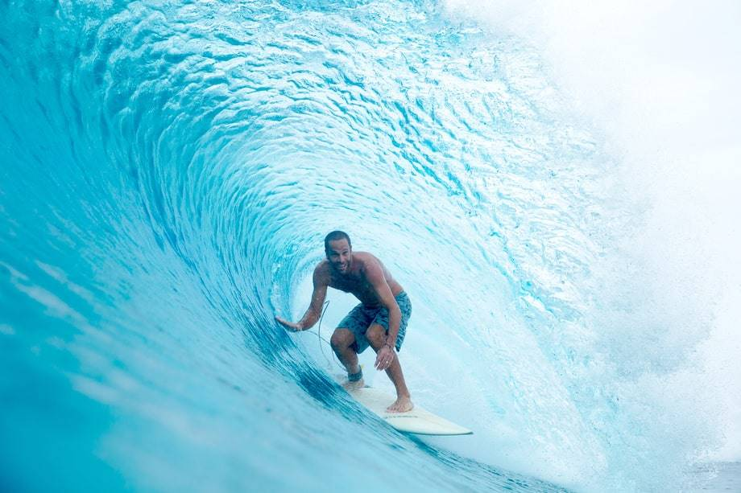

Slide 9
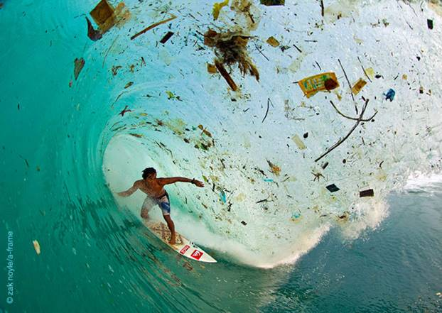

Slide 11
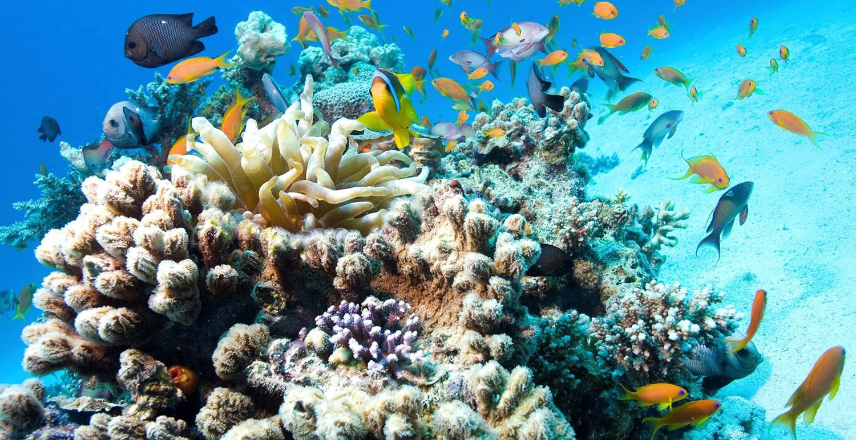

Slide 12
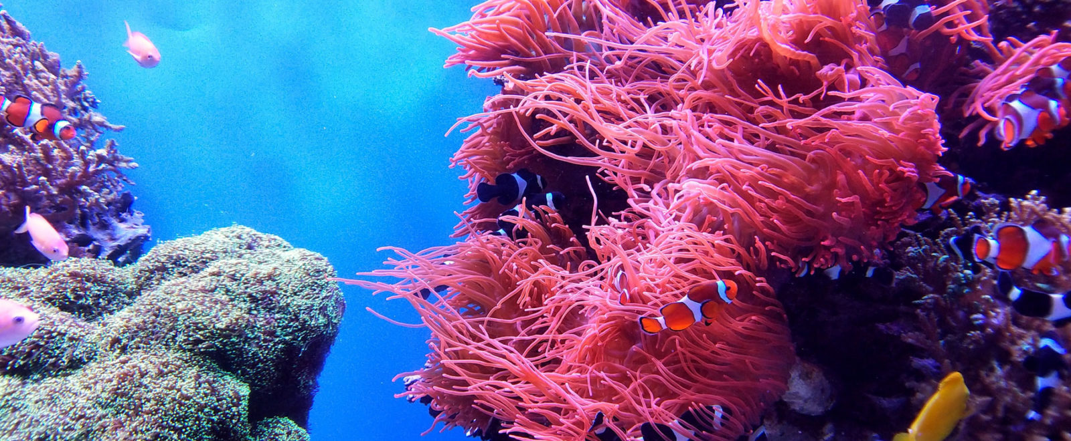
Coral covers just 0.1% of the ocean bed yet sustains 25-30% of marine life

Slide 13
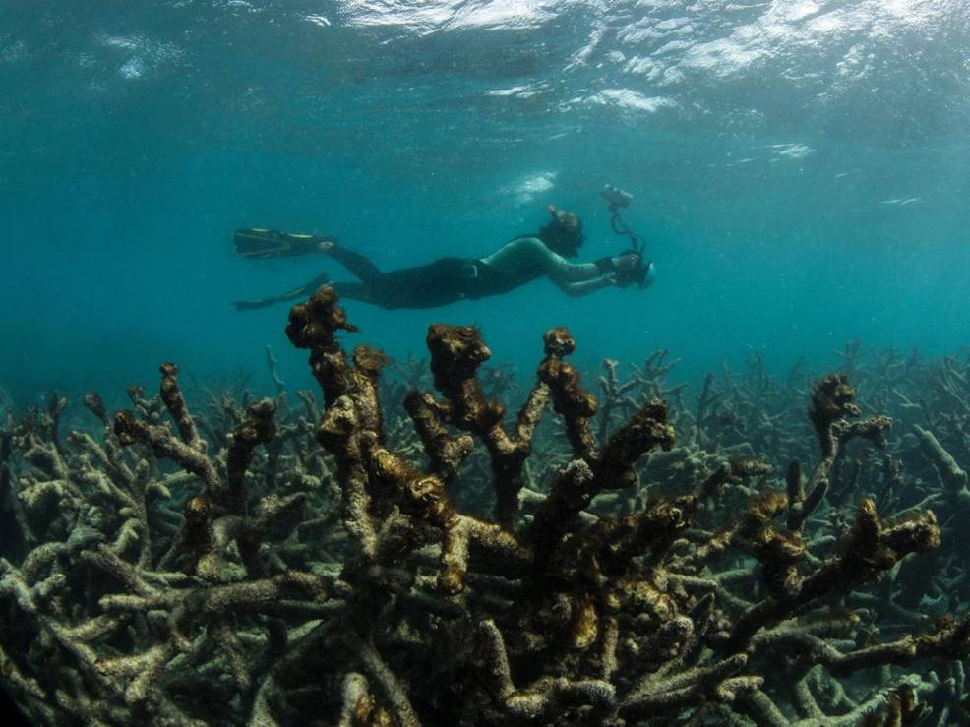
“The Great Barrier Reef may no longer be salvageable”

Slide 14
Coral is Moral is our new campaign to have the coral killer oxybenzone banned from around 3,500 different sunscreens.

Slide 15
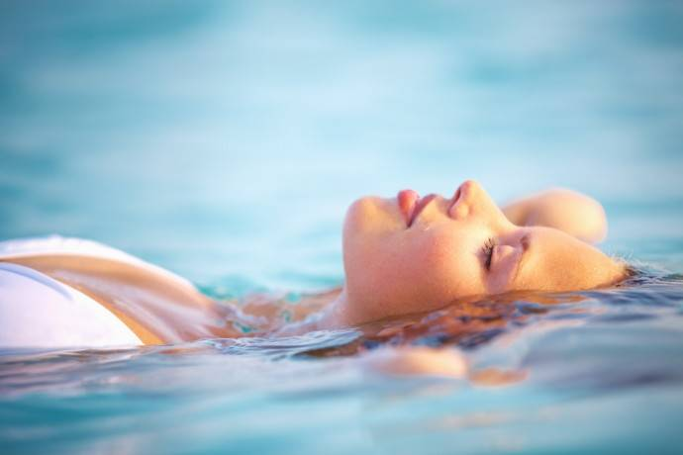
When sunscreen washes off into the sea, oxybenzone and titanium dioxide & zinc oxide nanoparticles in most sunscreens cause a spike in hydrogen peroxide levels in the seawater, which can make it uninhabitable for coral.
http://www.billionaire.com/body/body-products/1209/allard-marx-and-aethic-sve-fighting-ocean-pollution-with-coralfriendly-sunscreen

Slide 17
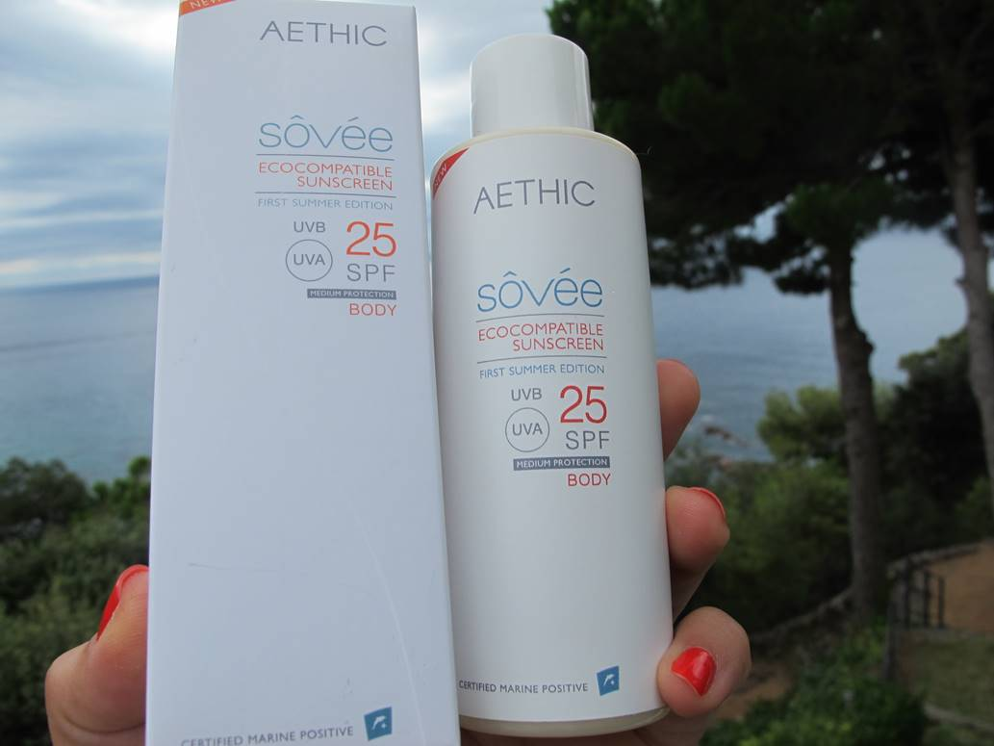
eco-compatible sunscreen

Slide 18
A range of other skincare products…
https://www.aethic.com/shop/

Slide 19
The task:
Aethic want to double the size of their business by the end of 2022, to move from the Introduction stage to the Growth stage of the PLC.
Assume the role of a strategic marketing consultant who has been hired to advise Aethic on how they can achieve this corporate objective.
Your task is to prepare a marketing plan to show how they can do this.
2,000 words max. Due: 13:00 (1pm) Wednesday 1st April 2020

Slide 20
Marketing Plan contents:
Marks
20
15
0
15
30
15
0
5
An Executive Summary
A brief summary of your marketing audit in the form of a well explained statement of any strengths, weaknesses, opportunities and threats, summarised as key issues.
Any assumptions that you have made and on which your plan depends
Marketing objectives for the 3 year period
The marketing strategy to be followed for the 3 years, in terms of targeting, positioning, and the marketing mix.
A detailed plan for Y1
Any contingency plans (eg in case your assumptions prove to be invalid)
A rough financial forecast for the 3 years down to contribution¹
Total Marks | 100
¹ Contribution is gross profit minus A&P (advertising & promotion) spend.

Slide 21
Financial Stuff:
Aethic’s worldwide sales are currently in the region of £1m.
We do not know their cost structure, so assume they operate at 50% gross margin.
Make your own recommendations about A&P spending.
All recommendations must be costed.

Slide 22
Some random thoughts & considerations:
What is the nature and size of the market in which Aethic operates? Does it matter?
How is the market segmented?
Who are the main players? Does it matter?
What is the situation and what are the main challenges facing the organisation?
How do buyers behave in this market?
What market segments should Aethic target?
What positioning should they adopt in the minds of their target consumers?

Slide 23
Allard Marx on Pricing:
“Three cocktails in a ‘cool’ place in Central London costs £45+. For that price you protect yourself properly for an entire week, and feel good about leaving marine life intact.”
on Targeting:
“Women who spend £200+ a month on themselves and their looks in addition to clothes!”
Question it, challenge it: just because the client said it, that doesn’t mean it’s right…

